Slide 1

Art Theater Data Analysis
Jiyang Xu

Slide 2
Content
Problem Statement and Main Goals:
Brief introduction of the target
Data Visualization:
Data visualizations generated
Data Preprocessing:
Key features and organizing data sets
Statistical Tests & Models:
Rigorous statistical tests and models to address problem
Potential Improvement & Conclusion:
Conclusion and potential future improvements

Slide 3
Problem Statement and Main Goals
What is the business trends of the art theater since 2016 until it closes in 2019?
Are the movie genres vary with concession types and audience group? Does these preferences and connections has influence on the closure?
What insights and suggestions could we learn from the "former glory" and business failure of the art theater for similar art house theater business?

Slide 4
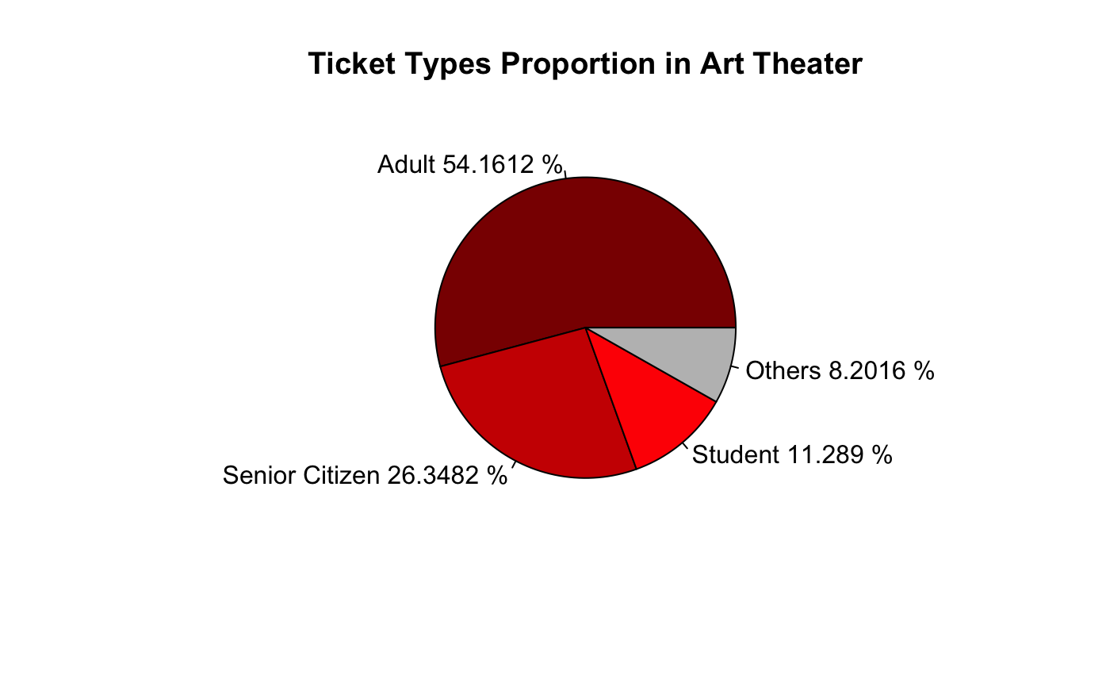
How Audience Group Distributed?

Slide 5
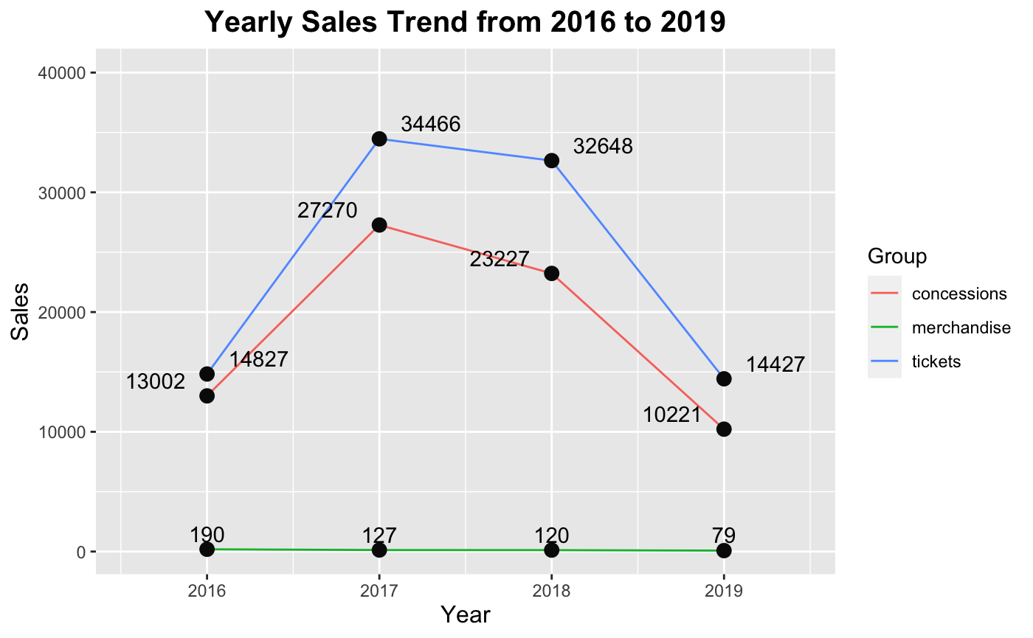
How Does Sales Distributed?
​

Slide 6
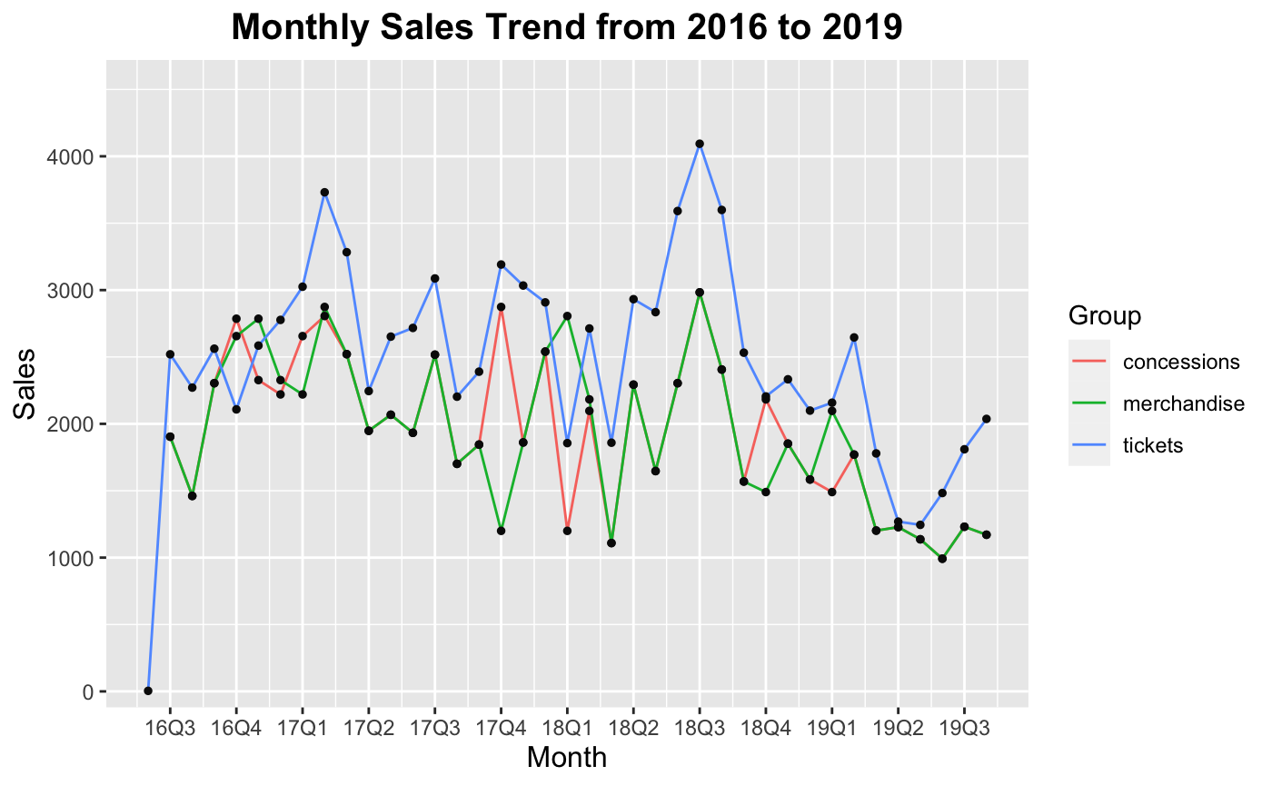
How Does Sales Distributed?
​

Slide 7
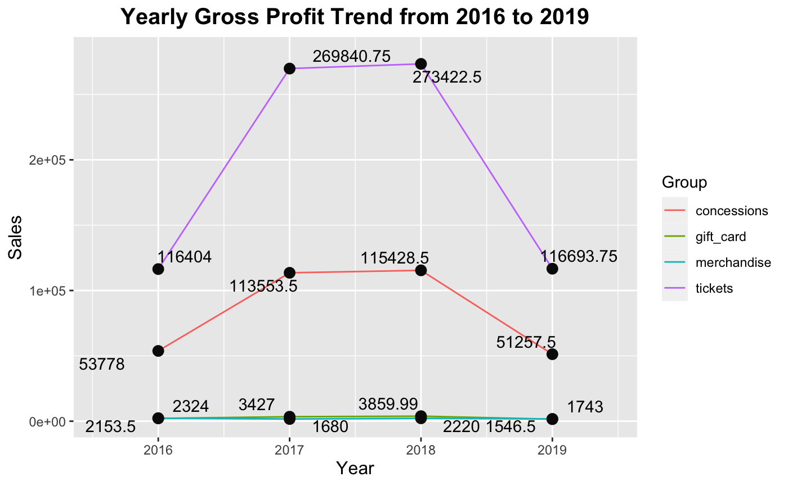
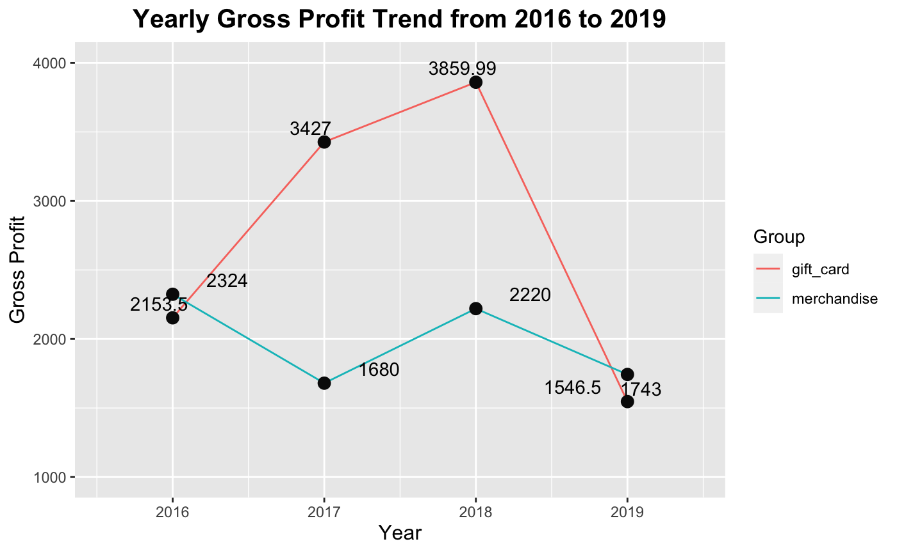
How Does Gross Profit Distributed?
​

Slide 8
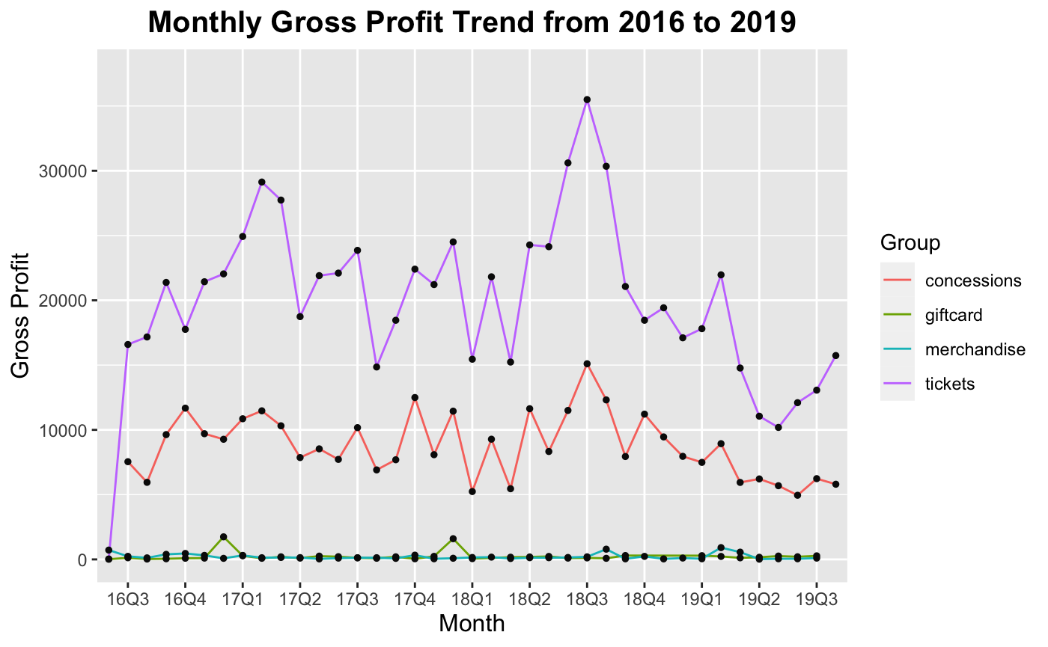
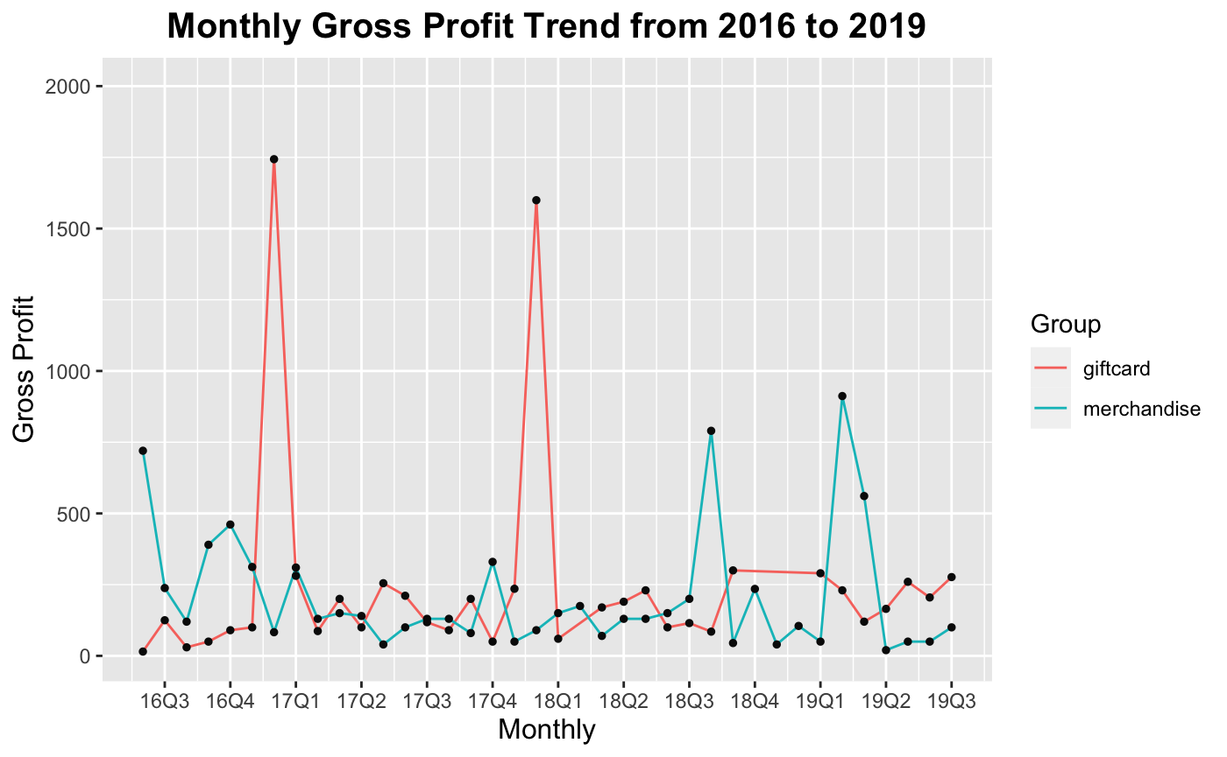
How Does Gross Profit Distributed?

Slide 9
Data Preprocessing
Concession Sales
Ticket Sales
Genres (External Dataset)
Wide format transformation
Group by order time
merge
Wide format transformation
Group by order time and ticket type
merge
Main movie genre
Movie title
Year
Etc.

Slide 10
Key Features
Eventname
Name of the movie/event etc.
Order Date
Date of this purchase record
Adult & Senior Citizen & Student & Other
Categorical: ticket type of this purchase record
Candy & Popcorn & Booze & Non Alcoholic
Categorical: concession type of this purchase record
Main Genre
Categorical: movie genre of this purchase record

Slide 11
Testing (Chi-Square)
Genre & Ticket Type
Genre & Concession
Type
Ticket Type &
Concession Type
All categories significant at 0.01 level
All categories significant at 0.01 level
All categories significant at 0.01 level
Both ticket type and concession type have strong relationship with genre.
Ticket type and concession type have strong relationship.

Slide 12
Modeling
(Multinomial Regression)
Response: main genre
Predictors:
Ticket type: Adult, Senior Citizen, Student, Other
Candy, Popcorn, Non-Alcohol, Booze
VGLM library
vglm()
NNET library
multinom()
Final Model:
Adult & Senior.Citizen & Student & Other & Popcorn

Slide 13
Fun Facts
“Student” audience group are willing to try a variety of movie genres
“Student” audience groups prefer “Booze” products
“Adult” audience group prefer “Comedy” & “Drama” than other movies
“Other” audience group tend to not prefer “Drama”
Audience for “Crime” movie tend to not prefer “Candy”
“Adventure” movies audience do not prefer “Booze” than “Candy” and “Popcorn”
“Adult” audience do not prefer prefer “Animation”
…

Slide 14
Potential Improvements
More Advanced Model
More Business Insights
Machine Learning Models
Model Comparison
Provide more business strategy suggestions based on analysis

Slide 15
Thank You
Reference:
IMDb 5000+ Movies & Multiple Genres Dataset. (2022, October 29). Kaggle. https://www.kaggle.com/datasets/rakkesharv/imdb-5000-movies-multiple-genres-dataset

